Slide 1
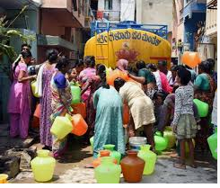
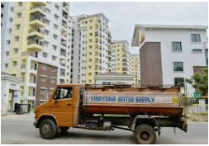
Current water sources??
Cauvery
Bore well
Tankers
Notes:
Cauvery – not meeting people needs - 900 million liters supply – 1.3 billion
Borewell – Almost all bore wells were dried up
Tankers – Only source which serving the needs of the people but quality is always question ( Hard water , TDS)

Slide 2
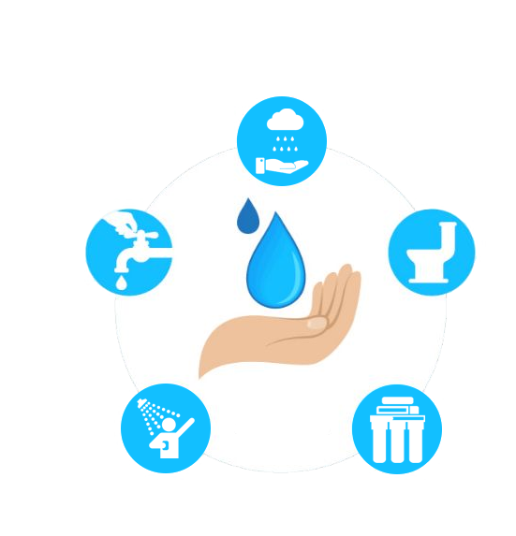
How can overcome??
These are some of the remedies
Rain Water Harvesting
Water re-use through Reverse Osmosis(RO)
Water Conservation (Short shower, Use a cup water for brushing, Vegetable washing)
Educate People
Afforestation
Sewage treatment
Notes:
Turn off the tap when you clean your teeth. A running tap uses up to nine litres of water a minute.
A five-minute shower uses about 40 litres of water.

Slide 3


